Slide 1
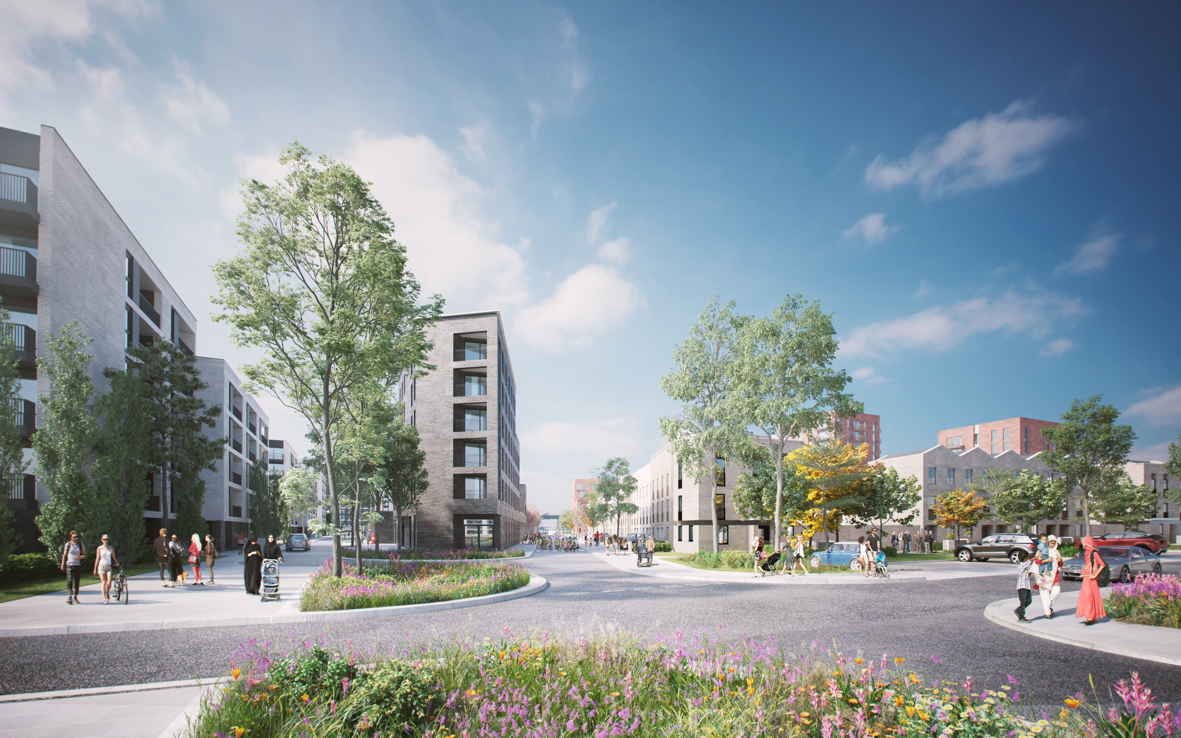

An Introduction to Social Value
22.02.2022
Tasha Worrall & Rachel Kirkwood

Slide 2
Agenda
Introductions
Aims and Objectives
What is Social Value?
Case Studies
Breakout Rooms + Feedback
  How do you contribute to Social Value?
  What is your organisation doing well/what could be done better?
5. Social value commitment
6. Q&A and Resources

Slide 3


Intro to Us
Tasha Worrall
Environmental Planner
Rachel Kirkwood
Social Impact & Engagement Consultant

Slide 4
Aims and Objectives
To provide an introduction to what social value is and understanding of why it’s important
To identify the different ways in which we all already contribute to social value
To take away some ideas on how we could further contribute to social value through our work in the engineering and construction industry

Slide 5
Quick poll
What is your current understanding of social value?
  Rate your answer 1-5
1 – 5 where 1 is ‘I know nothing at all about Social Value’ and 5 is ‘I am extremely knowledgeable about Social Value’

Slide 6
What is Social Value?
Hands up / answers in the chat!

Slide 7


Context to Social Value
SOCIAL VALUE
Social value
is increasingly important in procurement, tendering and project delivery.
Social value = wellbeing (human) in the short term and long term
Social value is the result and purpose of sustainability.
British Standard- Delivering and Enhancing Social Value (Dec 2020)

Slide 8
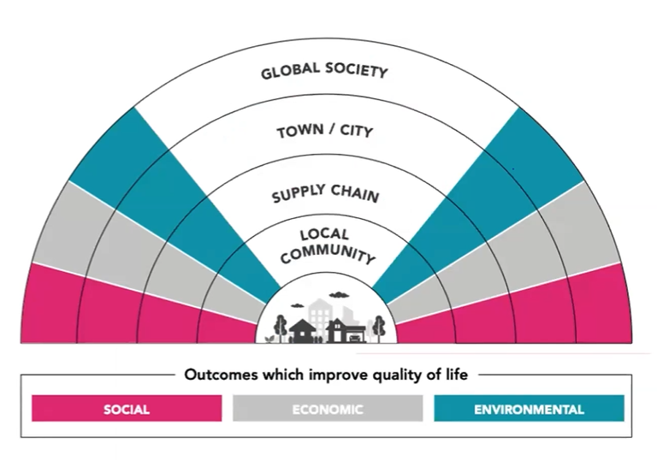
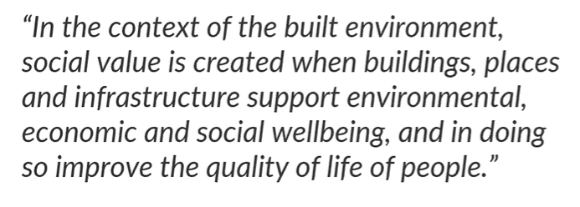
What is Social Value?
UK Green Building Council Definition

Slide 9
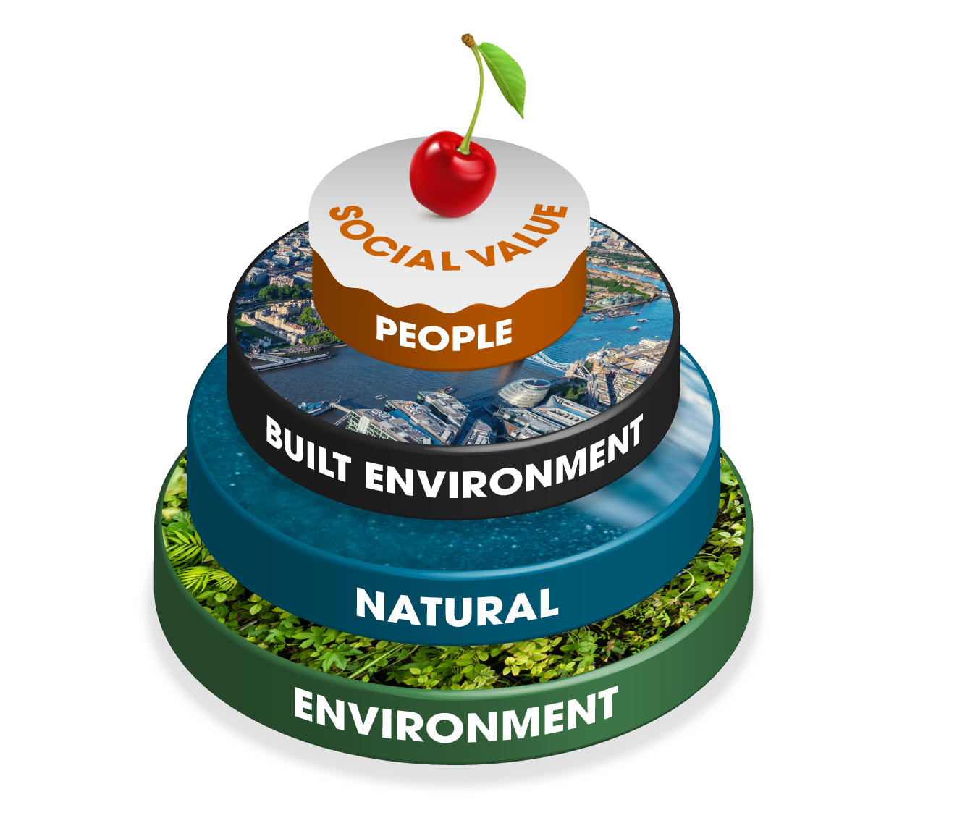
Social value is not the icing on the cake

Slide 10
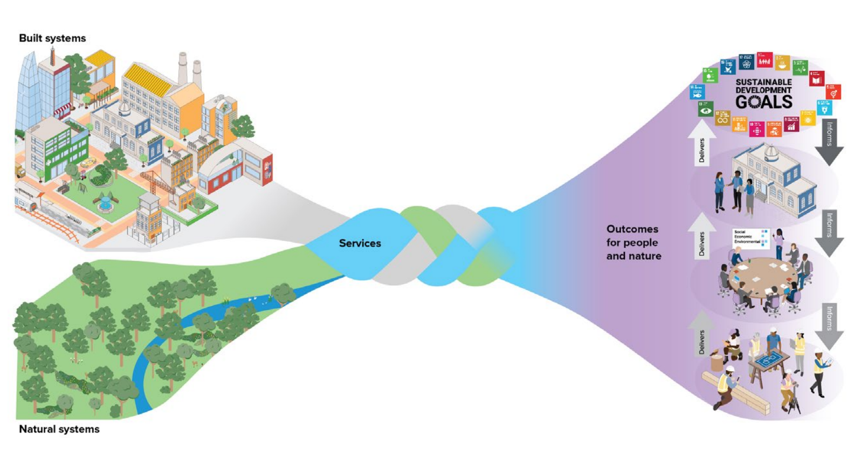
Delivering Social value looks more like this…
Notes:
IPA_TIP_Roadmap_to_2030_v6__1_.pdf (publishing.service.gov.uk)
Transforming Infrastructure Performance: Roadmap to 2030
The Infrastructure & Projects Authority (IPA) is the government’s centre of expertise for infrastructure and major projects. We sit at the heart of government, reporting to the Cabinet Office and HM Treasury

Slide 11

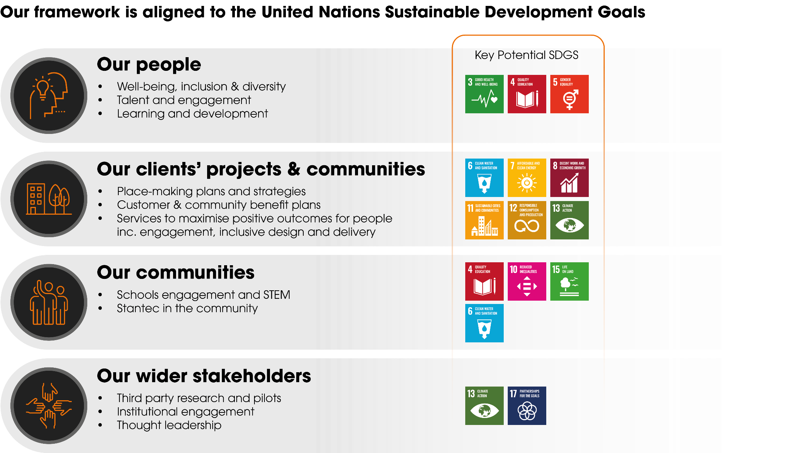

Our social value priorities

Slide 12
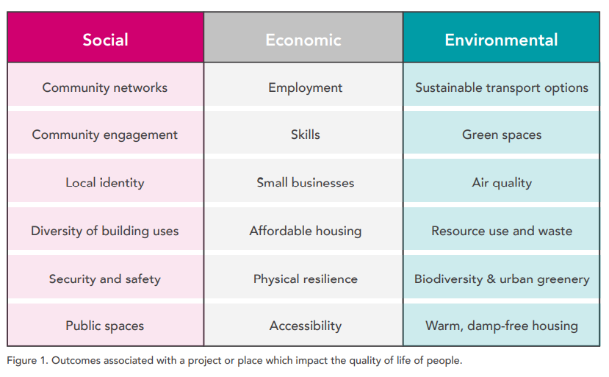
Social Value related project outcomes (UKGBC)

Slide 13
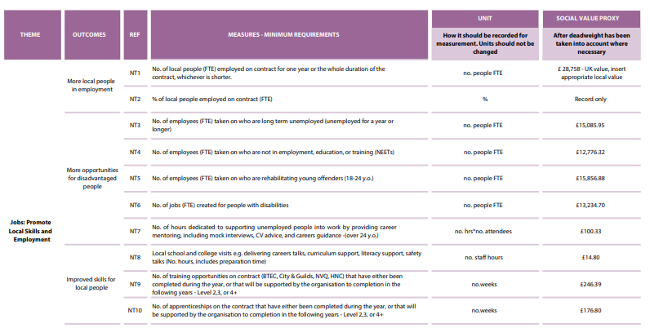
Measuring Social Value
Notes:
Light touch as could just talk about this for an hour!
But always gets asked
There are many different frameworks and tools for attributing a quantitative or financial value to social value measures with a lot of different research and methodologies going into each one. A common one you may have heard of is the National TOMS which stand for Themes Outcomes and Measures. It has over 70 different measures relating to many different aspects of SV and snippet on screen shows and example of how they are set out and the relevant financial values.
Sometimes can be useful to get people on side but people often attributing monetary values with no context or methodology which doesn’t count for much.
OK so you delivered 10 schools activities but what were the true outcomes? Qualitative stories can often be much more impactful.
A big area of consideration and expect to see a lot more change and research on this in future.

Slide 14
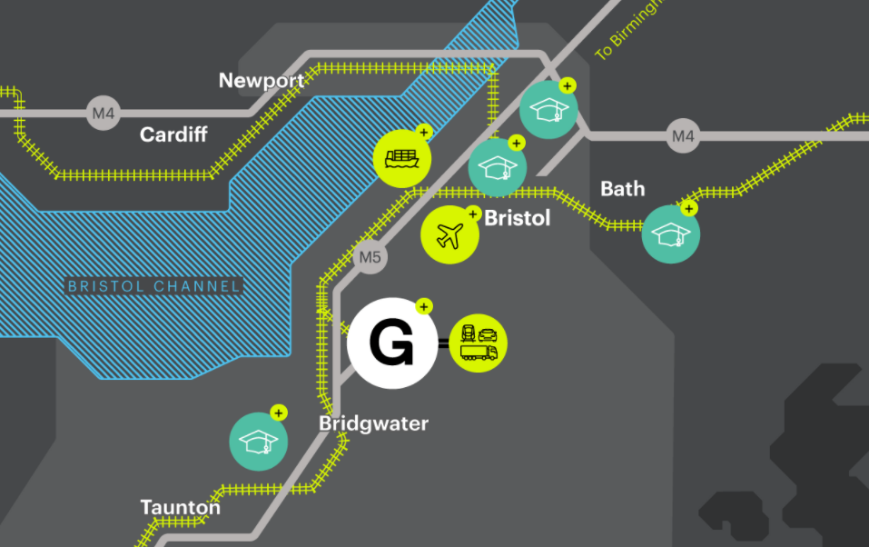
Case Study 1 – Gravity, South West of England
The UK’s first commercial ‘smart campus’
616 acre site located just off Junction 23 of the M5 near Bridgwater
Scalable, flexible and shared working space within a live-work-play campus, framed by a high quality natural environment
Commercial and advanced manufacturing e.g. electric vehicles, aerospace, agritech, battery manufacturing as well as sports, leisure, community, education and residential uses

Slide 15
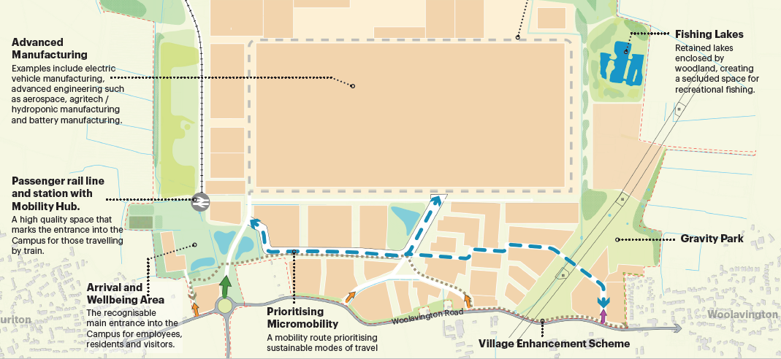

Slide 16
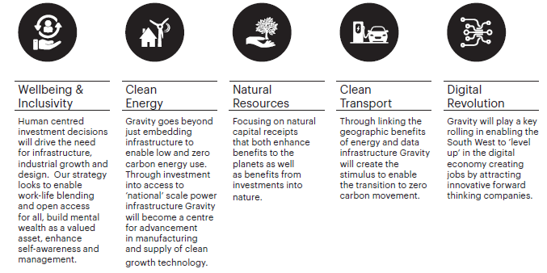

Slide 17
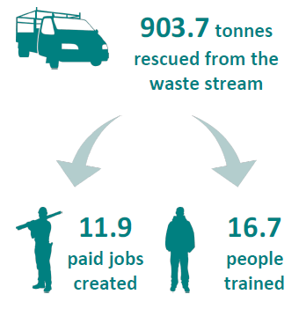

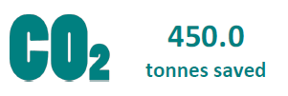
Case Study 2 – Wilmott Dixon and Community Wood

Slide 18
Breakout discussion
How do you contribute to Social Value in your role?
What do you think your organisation is doing well in terms of Social Value?
What would you like to see your organisation improve in the way they deliver Social Value?

Slide 19
Social Value Commitment
Make a personal commitment of one way in which you will further your contribution to Social Value going forwards
e.g. speak to other people in your team about SV, do some further research, get involved with a schools event or volunteering…
Answers in the chat!

Slide 20
Questions?

Slide 21
Resources
How the UK Is Promoting ‘Social Value’ Through Its Public-Sector Procurement Process - Sustainable Brands
Read this article on how the UK is promoting Social Value
Savills | Spotlight: Social value in European real estate – December 2021
This article from Savills explores what Social Value means to them and provides some case studies detailing Social Value in action in their projects.
Maximising_social_value_from_infrastructure_projects_v1.1.pdf (usefulprojects.co.uk)
This report from the Institution of Civil Engineers presents the findings of their research into the current approach to social value across the sector, implementation gaps, and to identify practical recommendation to close the gap and help the sector deliver impactful social value.
Framework-for-Defining-Social-Value.pdf (ukgbc.s3.eu-west-2.amazonaws.com)
Read this report by the UK Green Building Council which provides a framework for defining Social Value
Social-Value.pdf (ukgbc.s3.eu-west-2.amazonaws.com)
Read this report by the UK Green Building Council on Social Value in New Development
Delivering-Social-Value-Measurement.pdf (ukgbc.s3.eu-west-2.amazonaws.com)
Read this guide to measuring the Social Value of buildings and places
Future Manchester. An economy built on people, place and prosperity | Manchester City Council
An example of how Manchester City Council are reporting on Social Value achieved through projects in their city.
Social-value-and-design-of-the-built-environment.pdf (networkrail.co.uk)
A report published by the Supply Chain Sustainability School on generating Social Value through design

